Slide 1
Celebrity Look-Alike Facial Recognition
Team FACE-OFF: Motolani Alimi, Manny Darko, Jeff Roscal, Joe Spiwak, Mieae Yun

Slide 2
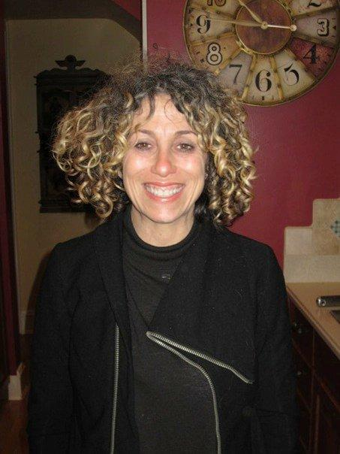
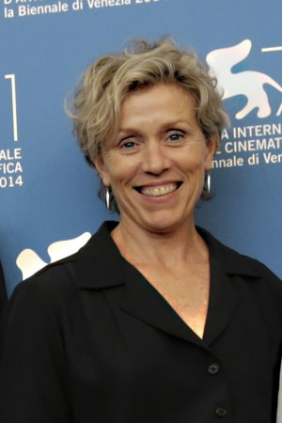
Funny Story...
Notes:
I’d like to start this off by sharing a funny story.

Slide 3

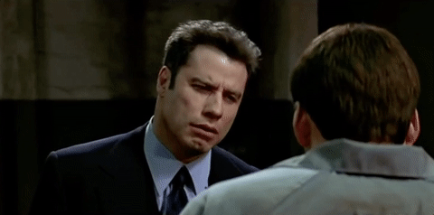
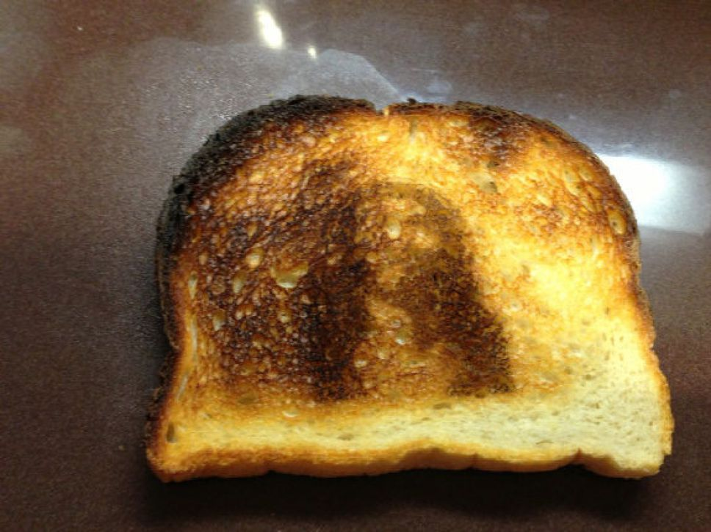
Why does this Happen?
Notes:
We as humans are hardwired to recognize patterns, which acts as the fundamental basis of intelligence, language, imagination, and invention. From an evolutionary standpoint, this particularly comes into play with faces, to the point that we as humans see faces wheever we looks, whether it be clouds, toast, or this cup.

Slide 4
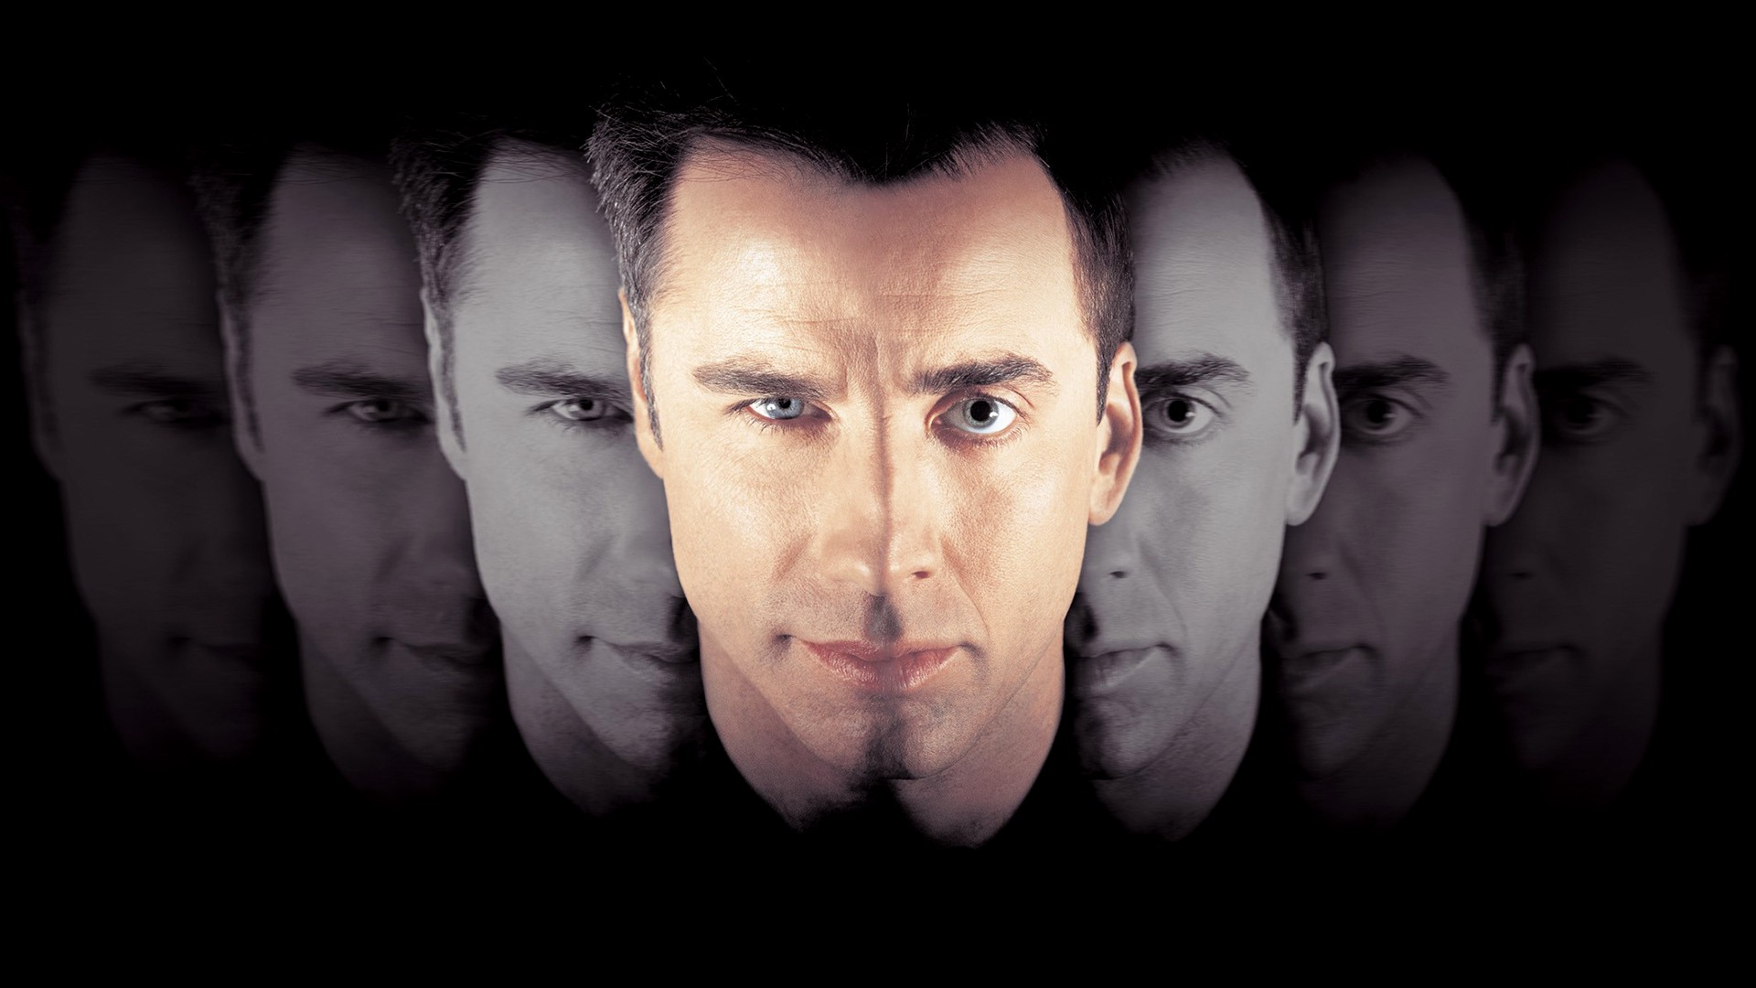
Our Project
API
Parallel Dots API
SightEngine API
Library
Camera
CV2
Flask
Keyboard
MatPlot
Software
HTML
Python
Pandas
Google Slides
Notes:
We sought to emulate this human behavior, using facial recogniton to match people’s photos with their celebrity look-alikes

Slide 5
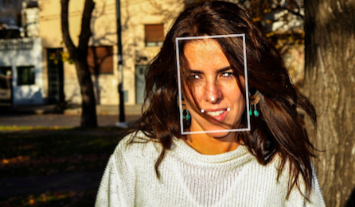
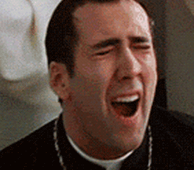
Problems
The amount of Data needed to train our model (without API)
Apparent limitations of the sample database the API draws from
Detection sensitivity lead to different answers for different photos
We weren’t able to predict age like we originally intended.

Slide 6
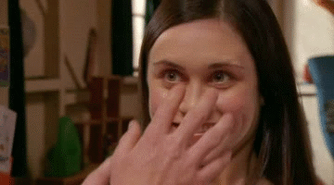
Demo

Slide 7
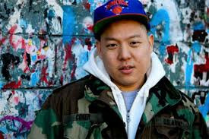
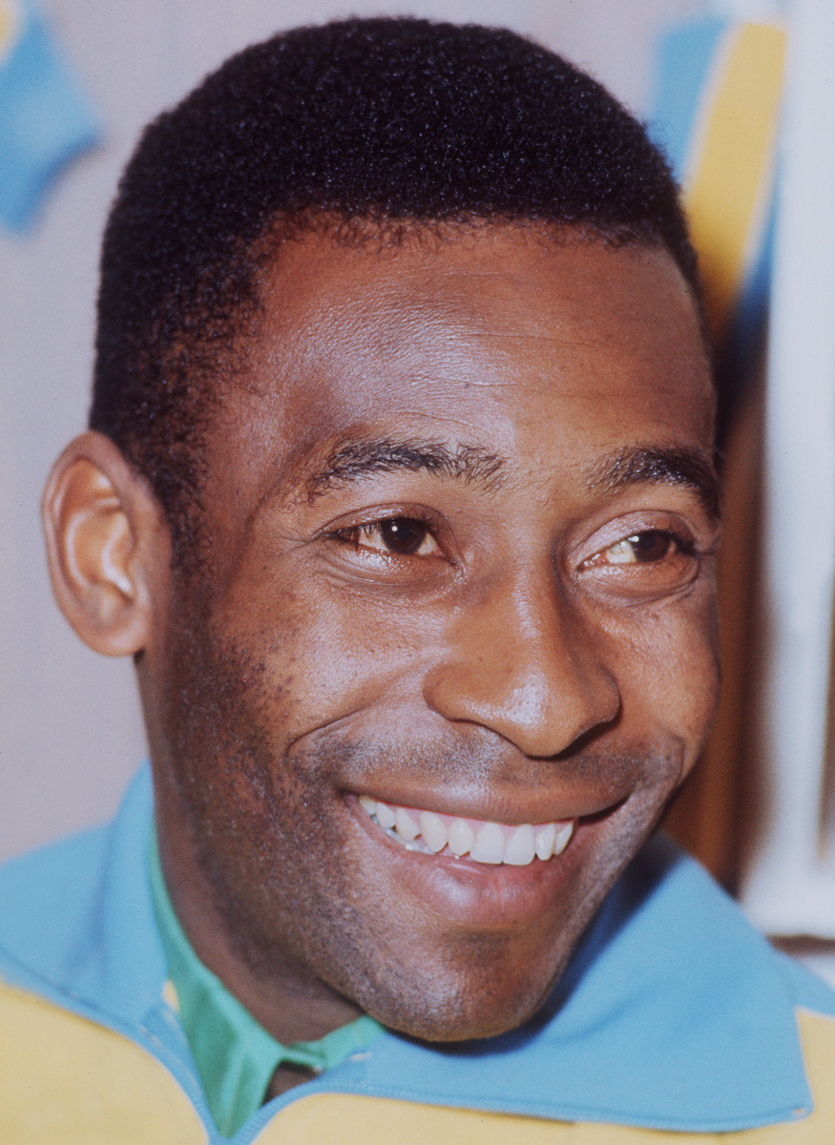
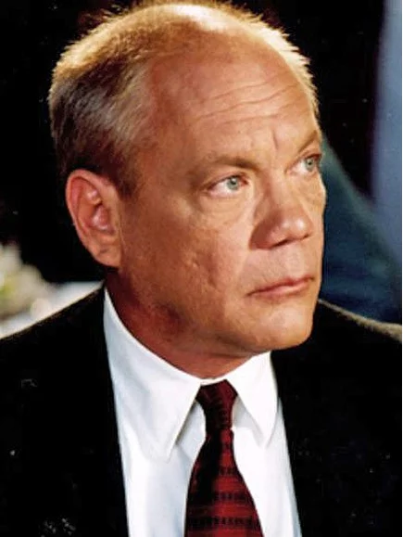
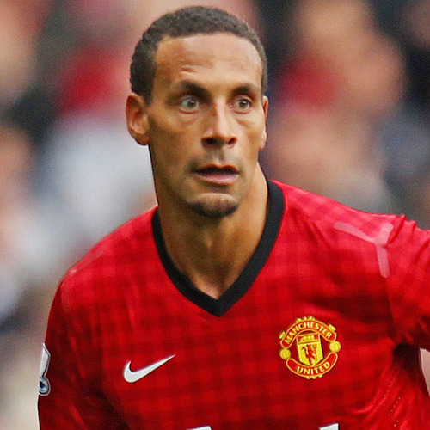
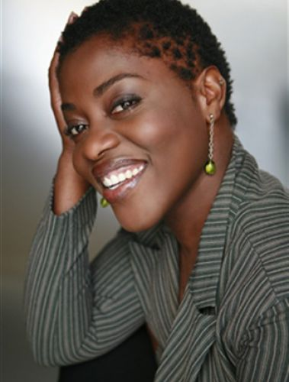

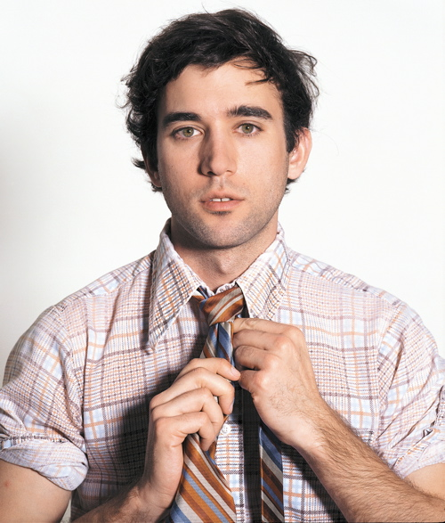
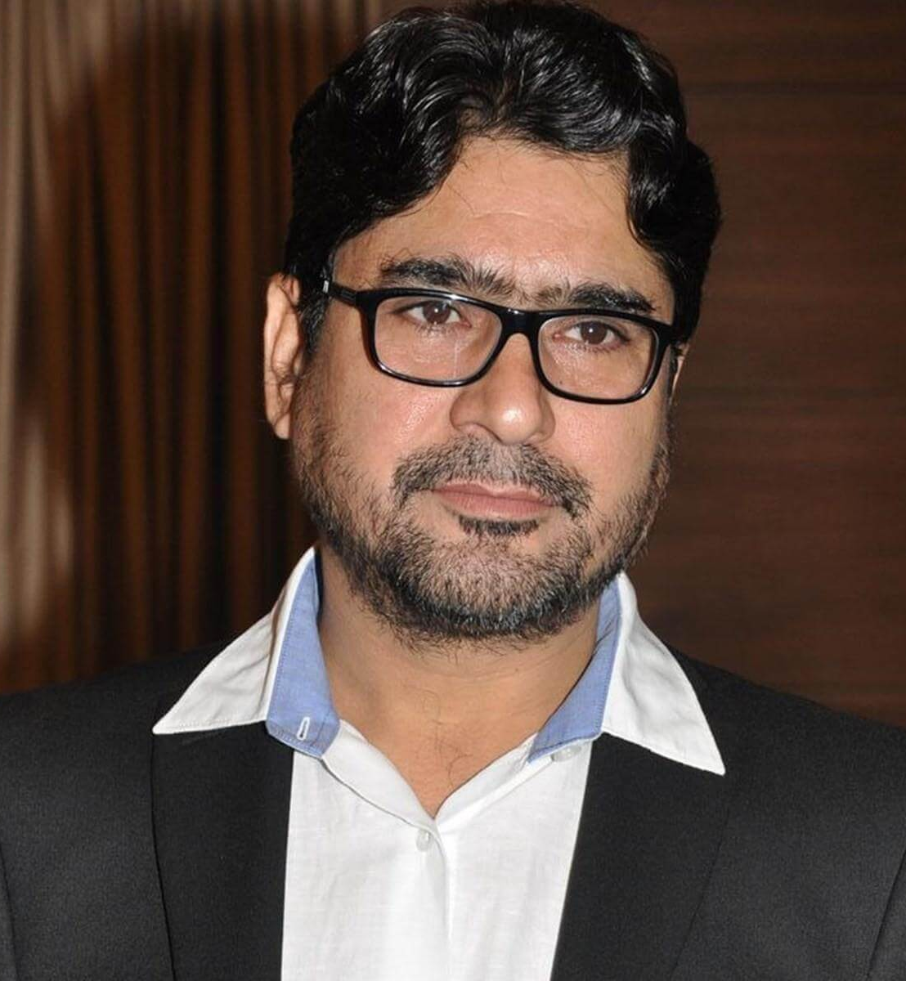
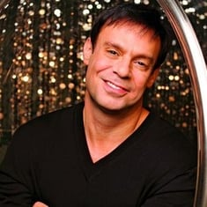
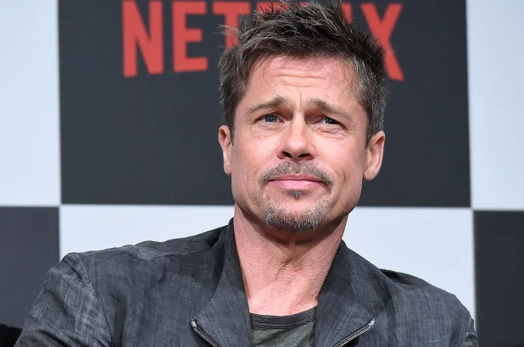
Results
Eddie Huang- 6% Jeff
Pele - 49% Manny
Daniel von Bargen - 28% Dwight
Rio Ferdinand- 20% Dartaniel
Claudia Tagbo - 40% Motolani
Sufjan Stevens - 24% Joe
Yashpal Sharma - 32% Kalpesh
Efim Shifrin - 9% Eli
Liza Lapira - 39% Mieae

Slide 8
Congratulations everyone! We Survived!

